Slide 1
KIRUTHIGA M
Final Project

Slide 2
HOTEL BOOKING ANALYSIS
Objective:
The objective of this analysis is to gain insights into booking patterns, optimal booking times, lengths of stay, and factors influencing special requests in two types of hotels: a city hotel and a resort hotel.
The primary objective of this analysis is to unravel the complexities of hotel bookings through comprehensive data exploration and analysis. By examining booking patterns, optimal reservation times, lengths of stay, and factors driving special requests, we aim to provide actionable insights for both city hotels and resort properties. Through this exploration, we seek to empower hotel management teams with the knowledge needed to make informed decisions, adapt to changing market dynamics, and deliver exceptional guest satisfaction.

Slide 3

AGENDA
Problem Statement
Project Overview
Who are thr end users?
Your Solution and its value proposition
The Wow is your solution
Algorithm & Deployment
Results
Conclusion
Future Scope
References
3/21/2024 Annual Review

Slide 4
PROBLEM STATEMENT
Develop a data set that contains booking information for a city hotel and a resort hotel, and includes information such as when the booking was made, length of stay, the number of adults, children, and/or babies, and the number of available parking spaces, among other things. All personally identifying information has been removed from the data. Explore and analyse the data to discover important factors that govern the bookings.

Slide 5
PROJECT OVERVIEW
Data Exploration: Understanding the dataset structure and checking data quality.
Descriptive Statistics: Calculating summary statistics and identifying trends.
Data Visualization: Visualizing booking patterns and exploring variable relationships.
Feature Engineering: Creating new features and transforming variables for deeper insights.
Analysis: Exploring factors influencing bookings and understanding trends.
Predictive Modeling (Optional): Forecasting future booking trends using predictive models.
Conclusion: Summarizing key findings and providing actionable recommendations.

Slide 6
WHO ARE THE END USERS?
Hotel Managers: Improve operations and guest experiences using insights.
Revenue Managers: Adjust pricing strategies based on booking trends.
Marketing Teams: Target specific customer segments for increased bookings.
Customer Experience Managers: Tailor services to meet guest preferences.
Data Analysts: Conduct research to inform strategic decisions.
Hospitality Consultants: Provide recommendations for operational improvements.

Slide 7
YOUR SOLUTION AND ITS VALUE PROPOSITION
Solution: We analyze hotel booking data to uncover trends and provide actionable recommendations for optimization. Empowering informed decision-making, we enhance operations, guest satisfaction, and revenue potential.
Value Proposition: Our analysis provides data-driven insights for informed decisions, optimizing operations, enhancing guest satisfaction, and maximizing revenue.

Slide 8

THE WOW IN YOUR SOLUTION
We transform raw data into actionable insights, revolutionizing how hotels operate, delight guests, and drive revenue.
Our transformative approach doesn't just analyze data—it transforms it into actionable strategies that propel hotels towards unprecedented success.
3/21/2024 Annual Review

Slide 9
ALGORITHM & DEPLOYMENT
Data Loading: Load the hotel booking dataset into memory.
Data Preprocessing: Check for missing values and handle them appropriately (e.g., imputation, removal).
Convert categorical variables into numerical representations (e.g., one-hot encoding, label encoding).
Exploratory Data Analysis (EDA):Examine the distribution of each feature (e.g., histograms, box plots).
Explore relationships between variables.
Feature Engineering:Create new features if necessary (e.g., total guests, total special requests).
Transform existing features if needed (e.g., date/time features into categorical or numerical representations).
Model Building:Select appropriate machine learning models based on the problem (e.g., regression for predicting daily rates, classification for predicting special requests). Split the dataset into training and testing sets.Train the models on the training set.

Slide 10
Contd.
Model Evaluation:Evaluate the performance of the trained models using appropriate metrics (e.g., mean squared error for regression, accuracy for classification).Tune hyperparameters if necessary using techniques like cross-validation.
Interpretation and Insights:Interpret the model results to understand the factors that influence hotel bookings (e.g., feature importance, coefficients).Extract insights from the analysis to answer questions such as the best time to book a hotel room, optimal length of stay, and factors contributing to special requests.
Visualization:Visualize the results and insights obtained from the analysis using plots and charts (e.g., bar plots, heatmaps, line graphs). Provide clear and intuitive visualizations to communicate findings effectively.

Slide 11
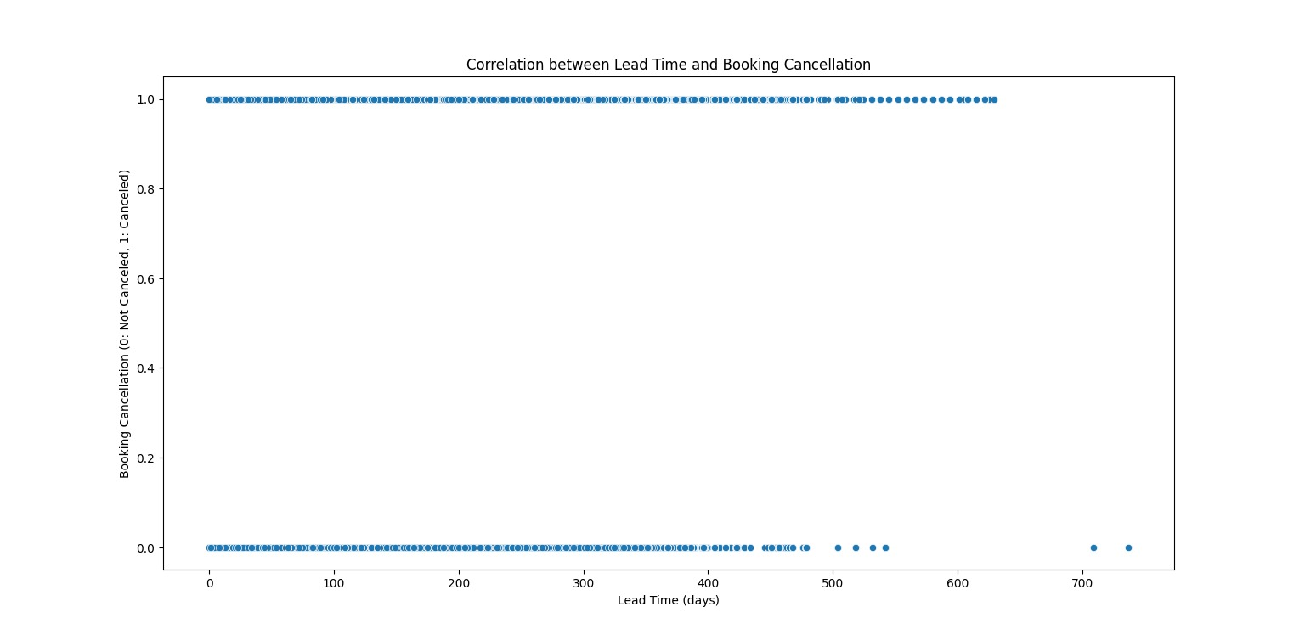
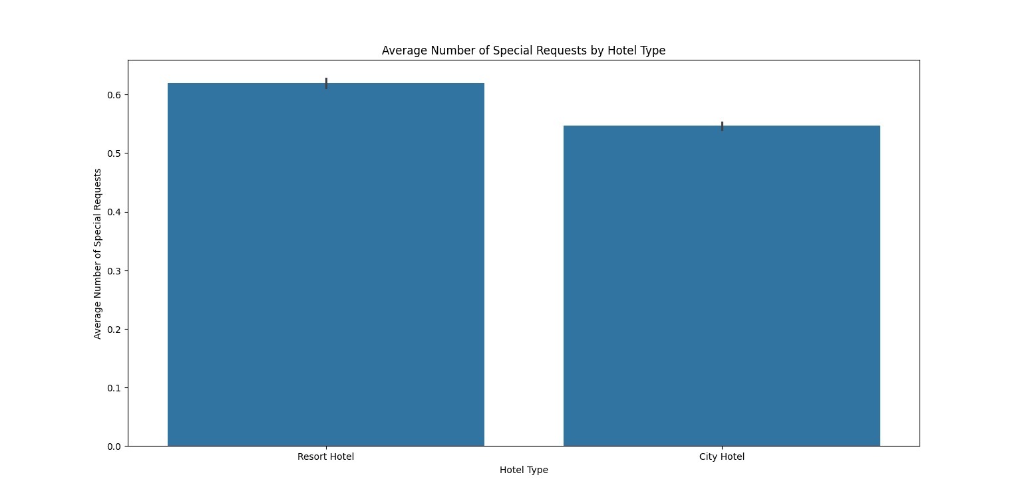
RESULTS

Slide 12
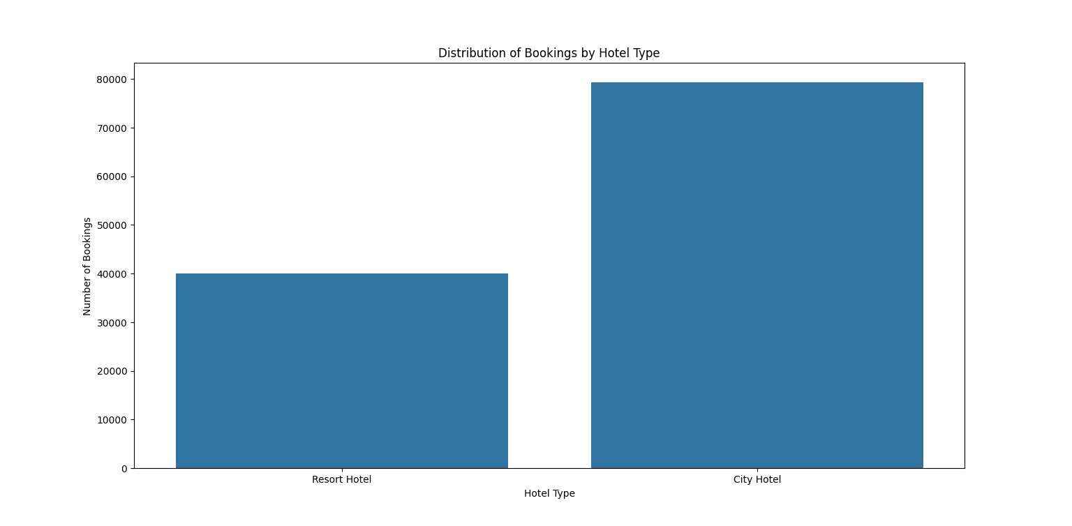
RESULTS

Slide 13
CONCLUSION
The project revealed insights into various factors affecting hotel bookings, including seasonal variations, lead time impact, demographic factors, and amenities. By analyzing these patterns, hotels can better understand customer behavior, optimize operations, and enhance customer satisfaction.
Additionally, the developed predictive model offers a tool for forecasting booking cancellations, enabling proactive management of resources and revenue. These conclusions underscore the importance of data-driven strategies in the hospitality industry to meet customer needs effectively and maximize profitability.

Slide 14
FUTURE SCOPE
The future scope for this project includes implementing dynamic pricing strategies, personalized marketing campaigns, and customer experience optimization based on the insights gained from the analysis.
Integrating the predictive model with revenue management systems, exploring additional data sources, and developing real-time monitoring systems are also essential.
Furthermore, conducting benchmarking studies and expanding the analysis to other hospitality segments could provide valuable insights and opportunities for improvement within the industry.

Slide 15
REFERENCES
https://www.kaggle.com/datasets
https://pandas.pydata.org/pandas-docs/stable/user guide/index.html
https://seaborn.pydata.org/
https://matplotlib.org/stable/contents.html

